Slide 1
HNDIT1101: Personal Computer Applications
Week 01 -

Slide 2
Module Aims
To develop skills and knowledge required in using computers in an office environment for general office applications.

Slide 3
Learning Outcomes
At the end of the module the student will be able to:
  Describe suitable types of software for general office activities and simple work automation.
  Effectively use a word processing software.
  Effectively use a spreadsheet software
  Prepare effective presentations using Presentation software
  Create and use simple databases on desktop environments

Slide 4
Outline Syllabus
Office Productivity software
Word processing software
Spreadsheets
Presentation software
Database management system

Slide 5
Assessment and Weighting
Continuous Assessment | Lab Assignment 1 - Individual | 20%
 | Lab Assignment 2 - Individual | 20%
 | Lab Assignment 3 - Group | 10%
End of semester examination | Final Structured Paper | 50%

Slide 6
Office productivity tools
Week 01

Slide 7
Categories of Computer Software
Software
System S/W
Operating System
Utility Programs
Application S\W
Packages
Language Translators
Bootstrap loaders
Diagnostic routine
Database Management Software
Languages
Highlevel Languages
Lowlevel Languages
Special Purpose Packages
General Purpose Packages

Slide 8
Why we need office productivity tools?
Office Productivity tools are used to create, view and modify a document to make it suite for it’s purpose.

Slide 9
Office productivity applications
Office Productivity Application is a programs that help users produce things such as documents, databases, graphs, worksheets and presentations.
  OpenOffice
  Microsoft Office
  Zoho
  Quickoffice

Slide 10
Types of office productivity tools
Word processing
  Microsoft word, Google docs, Pages(Apple), AbiWord
Spread Sheet
  MS Excel, Calc (openoffice), Number(Apple), Sheets(Google docs)
Presentation
  MS PowerPoint, Prezi, keynote(Apple), Impress (Open office)
Database Management
  MS Access, SQL server, Oracal, My SQL

Slide 11
Question 1
What are the office productivity tools available currently. List down.
Complete the following table by using identified packages and its purpose
Package Name | Commonly used (Places) | Purpose

Slide 12
List of Office Productivity Tools
Free:
  Libre office
  Open Office
Paid:
  MS Office
  King soft
  Word Perfect Office

Slide 13
What is Word Processing?
The most commonly used application
It is the method by which documents are created, edited, formatted and printed.

Slide 14
What is Word Processor
Word processor is a software package that enables you to.
  Create
  Edit
  Format
  Save
  Print
  Future retrieval and reference
Document

Slide 15
Advantages of Word Processor
Word processor enables you to make changes to a document without retyping the entire document.
Quick and easy
Stored electronically

Slide 16
Application areas of word processing :
Business - Legal Copies, Letterheads, Letters, Memos, Circulars etc.
Education - To develop word processing skills from the very beginning
Home - Dealing with assignments being completed at home, or occasionally recreational ex. Maintaining diary

Slide 17
Document Cycle
Word processing software performs the following activities:
  Entering
  Editing
  Spelling checking and using thesaurus
  Formatting
  Saving
  Printing

Slide 18
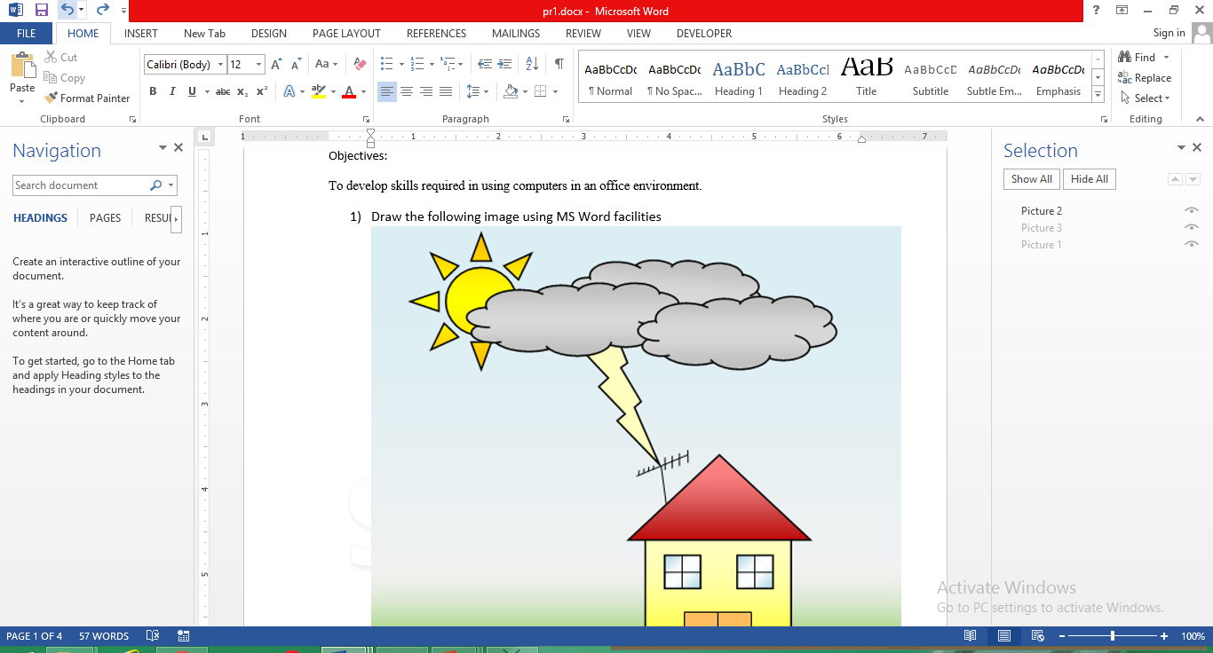
Word Interface
Quick Access Tool bar
Tabs
Ruler
Ribbon
Task
Pane
Text Area
Status bar

Slide 19
Elements in word window
Ribbon – Provides access to commands that are grouped according to the tasks you perform in word.
Tabs – provide one-click access to the group of commands on the ribbon.
Quick Access tool bar – Provides access to common commands you use frequently.
Ruler – Show page margins, tab stops , row heights and columns widths.
Task pane - quick access to common features, information, and commands.

Slide 20
Document Views
There are many ways to view a document in Word.
Print Layout: This is a view of the document as it would appear when printed. It includes all tables, text, graphics, and images.
Full Screen Reading: This is a full view length view of a document. Good for viewing two pages at a time.

Slide 21

Document Views.
Web Layout: This is a view of the document as it would appear in a web browser.
Outline: This is an outline form of the document in the form of bullets.
Draft: This view does not display pictures or layouts, just text.

Slide 22
End

